Slide 1

Futurense
Democratizing Tech Talent to deliver impact at scale
Submitted By :
P.Yasaswi Nikitha(FT767)

Slide 2
Healthcare census project

Slide 3
Overview:
Brief Description : The Objective of this project is to clean and analyse the census, Housing, Hospitals and Government Hospital Data. The main aim of this project is to remove the irrelevant data, Handle the missing values, Visualize the data and gain insights from it and Lastly it also the connection of the data with relational database and finally upload the cleaned data for access through the website
Business Problem : The business problem addressed by the Healthcare Census Project is the need to clean and analyze healthcare-related data, including census, housing, hospitals, and government hospital data. Ultimately, the project aims to contribute to improving healthcare planning and resource allocation based on accurate and analyzed data.
Solution Approach : The solution approach is Data Cleaning , Data Analysis, Database Connection, Verification, Running Queries we can attain our project

Slide 4




Tools and Technologies Used:
Tool 1
Tool 2
Tool 3
Tool 4
Python
SQL
Jupyter
Excel

Slide 5
Libraries/Packages/Features Used:
Matplotlib
Pandas
Seaborn
Numpy
DataBase Connectivity

Slide 6
Headline Statistics (1/2):
Average Execution Time=7.6sec
Wakatime Metrics
Lines of Codes (LoC/KLoC)=493
Total number of functions=27
Number of built-in functions used=24
Number of user-defined functions used=3
Avg. number of lines per function=6

Slide 7
Headline Statistics (2/2):
Number of comments written=15
IDE/Code Editor Used=Jupyter Notebook
Plugins Used=Numpy,pandas,Matplotlib
Function/Complexity breakdown:
Simple Implementations
Intermediate Implementations
Complex Implementations

Slide 8
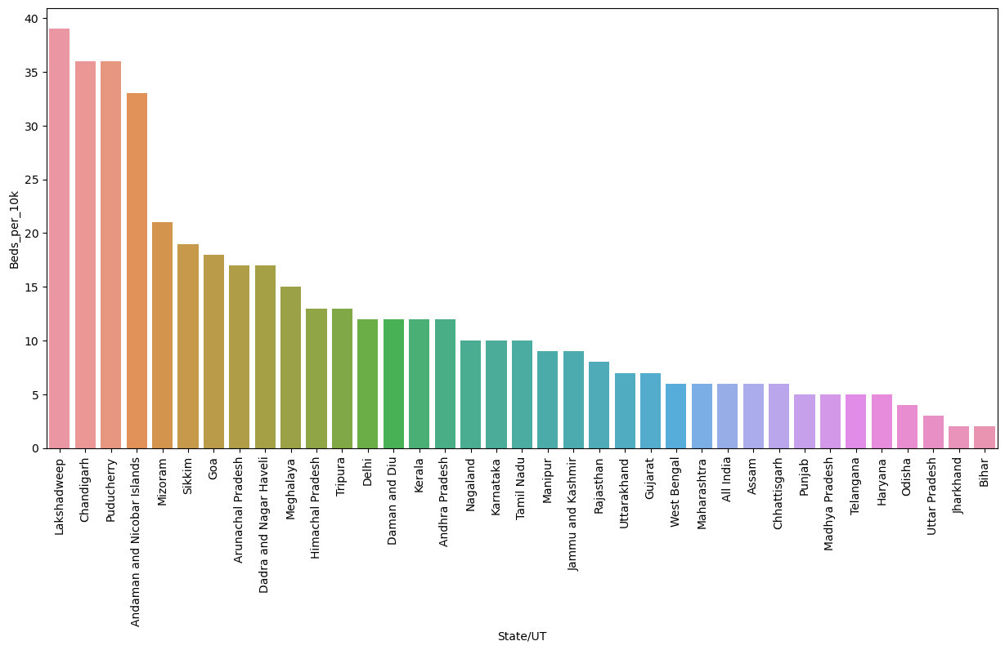
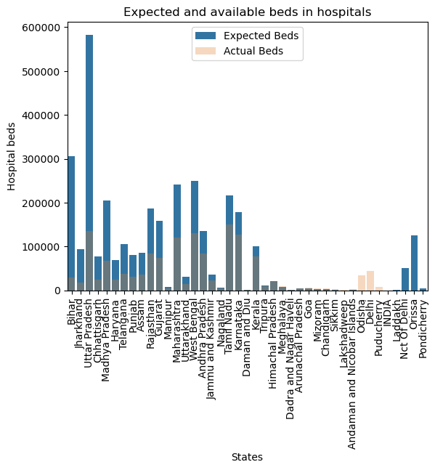
Relevant Diagram/s:

Slide 9
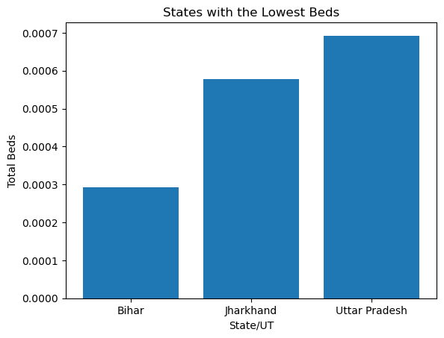
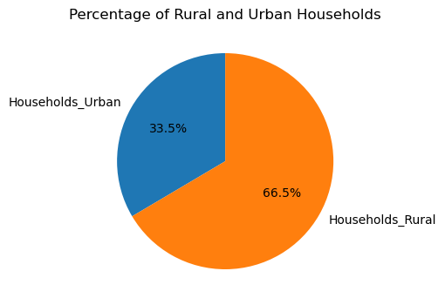
Relevant Diagram/s:

Slide 10
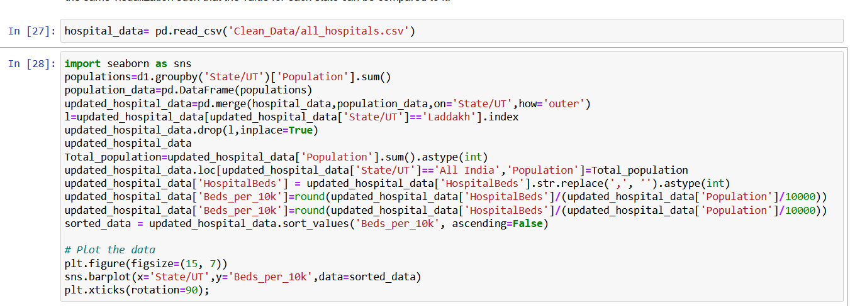
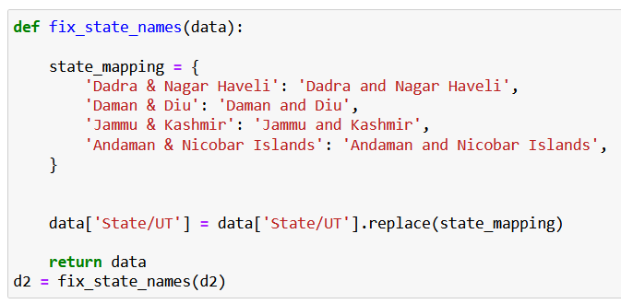
Implementation Screenshots/Code Snippets:

Slide 11
Highlights & Standout Features:
Comprehensive Data Cleaning
Multi-Dimensional Analysis
Visual Data Exploration
Identification of Critical Area
Comparison with WHO Standards
Database Connectivity and Data Upload

Slide 12
Optimizations and Best Practices Used:
Modular Code Structure : The project follows a modular code structure, breaking down tasks into functions and classes
Efficient Data Cleaning Techniques : The project utilizes efficient data cleaning techniques such as dropping irrelevant columns, renaming columns for clarity, standardizing state/UT names, and filling missing data using calculated values
Vectorized Operations : When performing data cleaning and transformations, the project leverages vectorized operations provided by libraries like NumPy and Pandas. Vectorized operations are optimized for speed and efficiency, enabling faster data processing compared to iterative operations.
Visualization Best Practices : The project adheres to best practices for data visualization using libraries like Matplotlib and Seaborn. It uses appropriate chart types, labels, titles, and color schemes to effectively communicate insights and trends in the data
Database Connectivity and Constraints : The project establishes a connection to a relational database and sets up primary key and foreign key constraints in the tables
Documentation and Comments : The project includes thorough documentation and comments throughout the codebase. This documentation provides insights into the purpose, functionality, and usage of different components, making it easier for other developers to understand and maintain the codebase.

Slide 13
Roadblocks & Resolutions
Insufficient or Inaccurate Data: One of the main roadblocks in this project could be the availability of insufficient or inaccurate data
Data Standardization: Another challenge could be standardizing the data from different sources, such as census, housing, hospitals, and government hospitals. Each source may have its own data format, column names, or coding schemes
Complex Data Relationships: The project involves analyzing and connecting multiple datasets, which may have complex relationships. Joining the data tables correctly and setting up primary key-foreign key constraints can be challenging
Performance and Scalability: Analyzing and visualizing large datasets can be computationally intensive and may impact performance. The team should optimize their code and utilize appropriate data structures and algorithms to handle the data efficiently.
Documentation and Communication: Proper documentation of the project, including code, processes, and results, is essential for clarity and future reference
Insufficient or Inaccurate Data
Data Standardization
Complex Data Relationships
Performance and Scalability
Documentation and Communication

Slide 14
Future Scope:
Overall, the future scope of the Healthcare Census Project involves
Advanced Machine Learning Techniques : Implement advanced machine learning algorithms such as clustering, classification, or regression to uncover hidden patterns and relationships in healthcare data
Collaboration with Healthcare Organizations : Collaborate with healthcare organizations, research institutions, or public health agencies to gain access to additional datasets, domain expertise, and validation of project findings
Advanced Data Security Measures : Strengthen data security measures by implementing advanced encryption techniques, access controls, and auditing mechanisms to protect sensitive healthcare data
Advanced Visualization Techniques : While the project includes data visualization using libraries like Matplotlib and Seaborn, advanced visualization techniques can be explored.
Integration with Electronic Health Records (EHR) : Integrating the project with electronic health records can provide a more holistic view of healthcare data. This can involve extracting and analyzing data from EHR systems, combining it with census and other datasets, and performing comprehensive analytics
Performance Optimization : As the project scales and handles larger datasets, performance optimization becomes crucial. Implementing techniques like parallel processing, distributed computing, or utilizing cloud services can improve the efficiency of data cleaning, analysis, and database operations

Slide 15
Thank You

Slide 16




















